Slide 1
Applied Machine Learning and Data Mining
Week 9: Machine Learning Algorithms: Classification Part 1
Dr. Alaa Mohasseb

Slide 2
Last Week
Identify how to select the appropriate modelling technique.
Understand the difference between supervised and unsupervised learning.
Learn the different types of supervised and unsupervised learning algorithms.

Slide 3
Outline for Today
Understand the concepts of machine learning classification algorithm Naive Bayes.
Learn how to train / test the data.
Differentiate between model evaluation metrics.

Slide 4
Classification: Definition
Classification is a technique where data is affiliated under certain labels.
The algorithms and models could be trained to classify data under different classes.
For example, if you have data of fruits consisting of apples and oranges, your model will learn from the data about the specifications of the fruits. The next time you enter new data, the model will compare your data and then classify it under either class.
Classification means to group the output inside a class.
If the algorithm tries to label input into two distinct classes, it is called binary classification.
Selecting between more than two classes is referred to as multiclass classification.

Slide 5
Classification: Definition
Given a collection of records (training set)
Each record is characterised by a tuple (x,y), where x is the attribute set and y is the class label:
x: attribute, predictor, independent variable, input
y: class, response, dependent variable, output
Task: Learn a model that maps each attribute set x into one of the predefined class labels y.

Slide 6
Classification Model

Slide 7
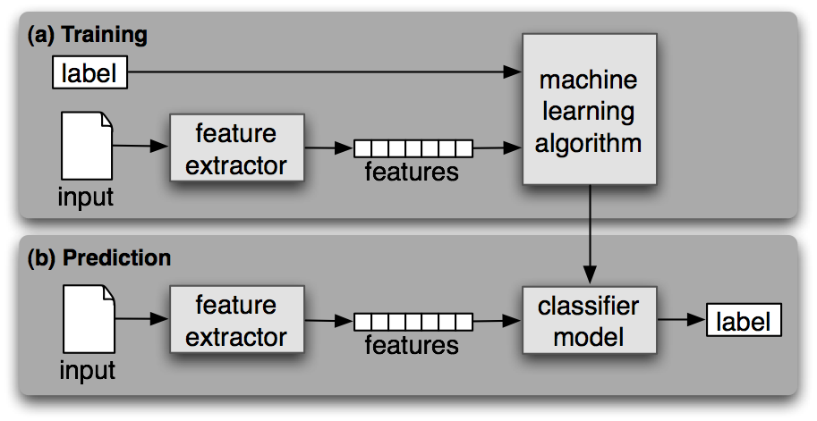
Classification Model: Example
Image source: https://www.nltk.org/images/supervised-classification.png

Slide 8
Example - Weather Dataset
Outlook | Temp | Humidity | Windy | Play Golf
Rainy | Hot | High | False | No
Rainy | Hot | High | True | No
Overcast | Hot | High | False | Yes
Sunny | Mild | High | False | Yes
Sunny | Cool | Normal | False | Yes
Sunny | Cool | Normal | True | No
Overcast | Cool | Normal | True | Yes
Rainy | Mild | High | False | No
Rainy | Cool | Normal | False | Yes
Sunny | Mild | Normal | False | Yes
Rainy | Mild | Normal | True | Yes
Overcast | Mild | High | True | Yes
Overcast | Hot | Normal | False | Yes
Sunny | Mild | High | True | No
Source: https://www.saedsayad.com/naive_bayesian.htm

Slide 9
Train and test
A technique for evaluating the performance of a machine learning algorithm.
The data set is split into two sets: a training set and a testing set.
Used for supervised learning algorithm.
Training Set
Data
Testing Set

Slide 10
Example
Ration Examples:
Learning Algorithm
Train 80%, Test 20%
Train: 67%, Test: 33%
Train: 50%, Test: 50% (Balanced Dataset)
Train 90%, Test 10% ( used with small dataset)
Train 70%, Test 30% (used when the model is computationally expensive)
Training Set
Split
Classifier
Test Set
Dataset
Estimate

Slide 11
Cross-Validation
Learning Algorithm
Cross-validation is a method for getting a reliable estimate of model performance using only your training data.
The most common method is, 10-fold cross-validation.
Split
Classifier
Dataset
Estimate

Slide 12
Steps for 10-fold cross-validation
k = 1
Holdout
k = 2
Holdout
k = 3
Holdout
k = 4
Holdout
k = 5
Holdout
k = 10

Slide 13
Steps for 10-fold cross-validation
Split your data into 10 equal parts, or "folds".
Train your model on 9 folds (e.g. the first 9 folds).
Evaluate it on the 1 remaining "hold-out" fold.
Perform steps (2) and (3) 10 times, each time holding out a different fold.
Average the performance across all 10 hold-out folds.
The average performance across the 10 hold-out folds is your final performance estimate, also called your cross-validated score.
Because you created 10 mini train/test splits, this score is usually reliable.

Slide 14
Features Scaling
Normalise the range of independent variables.
It is performed during the data pre-processing step.

Slide 15
Model Evaluation

Slide 16

Model Evaluation
Classification Metrics; the metrics used in classification problems are:
F-Measure
Area under Curve (AUC)
Logarithmic Loss
Confusion Matrix
Classification Accuracy

Slide 17
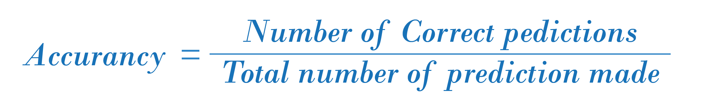
Classification Accuracy
Accuracy is a common evaluation metric for classification problems
It’s the number of correct predictions made as a ratio of all predictions made

Slide 18
Classification Accuracy
Accuracy works well only if there are equal number of samples belonging to each class.
For example, there are 98% samples of class A and 2% samples of class B in our training set. Then our model can easily get 98% training accuracy by simply predicting every training sample belonging to class A.
When the same model is tested on a test set with 60% samples of class A and 40% samples of class B, then the test accuracy would drop down to 60%.
Further Reading: https://towardsdatascience.com/metrics-to-evaluate-your-machine-learning-algorithm-f10ba6e38234

Slide 19
Confusion Matrix
A confusion matrix is also known as an error matrix.
A confusion matrix provides a more detailed breakdown of correct and incorrect classifications for each class.

Slide 20
Confusion Matrix
A table that is often used to describe the performance of a classification model (or “classifier”) on a set of test data for which the true values are known.
It allows the visualization of the performance of an algorithm.
It allows easy identification of confusion between classes
e.g. one class is commonly mislabeled as the other.
It gives us insight not only into the errors being made by a classifier but more importantly the types of errors that are being made
Most performance measures are computed from the confusion matrix.

Slide 21
Confusion Matrix - Definition of the Terms
Positive (P): Observation is positive (for example: is an apple).
Negative (N): Observation is not positive (for example: is not an apple).
True Positive (TP): Observation is positive, and is predicted to be positive.
False Negative (FN): Observation is positive, but is predicted negative.
True Negative (TN): Observation is negative, and is predicted to be negative.
False Positive (FP): Observation is negative, but is predicted positive.
Notes:
True positive= first word represent reality and second word represent outcome

Slide 22


Confusion Matrix - Example
Actually an Orange 106
Actually Not an Orange 60
Predicted class
P
N
True Positives
(TP)
False Positives
(FP)
Predicted
Orange
115
False Positives
10
P
True Positives
105
Actual class
False Negatives
(FN)
True Negatives
(TN)
N
Predicted Not
Orange
51
False Negatives
1
True Negatives
50
Source: Confusion-Matrix-1024x749.png

Slide 23
Logarithmic Loss
Logarithmic loss (log loss) measures the performance of a classification model where the prediction input is a probability value between 0 and 1
Log loss increases as the predicted probability diverges from the actual label.
The goal of machine learning models is to minimize this value. As such, smaller log loss is better, with a perfect model having a log loss of 0.
Further Reading:
https://en.wikipedia.org/wiki/Loss_functions_for_classification
https://towardsdatascience.com/understanding-binary-cross-entropy-log-loss-a-visual-explanation-a3ac6025181a
https://www.kaggle.com/dansbecker/what-is-log-loss

Slide 24
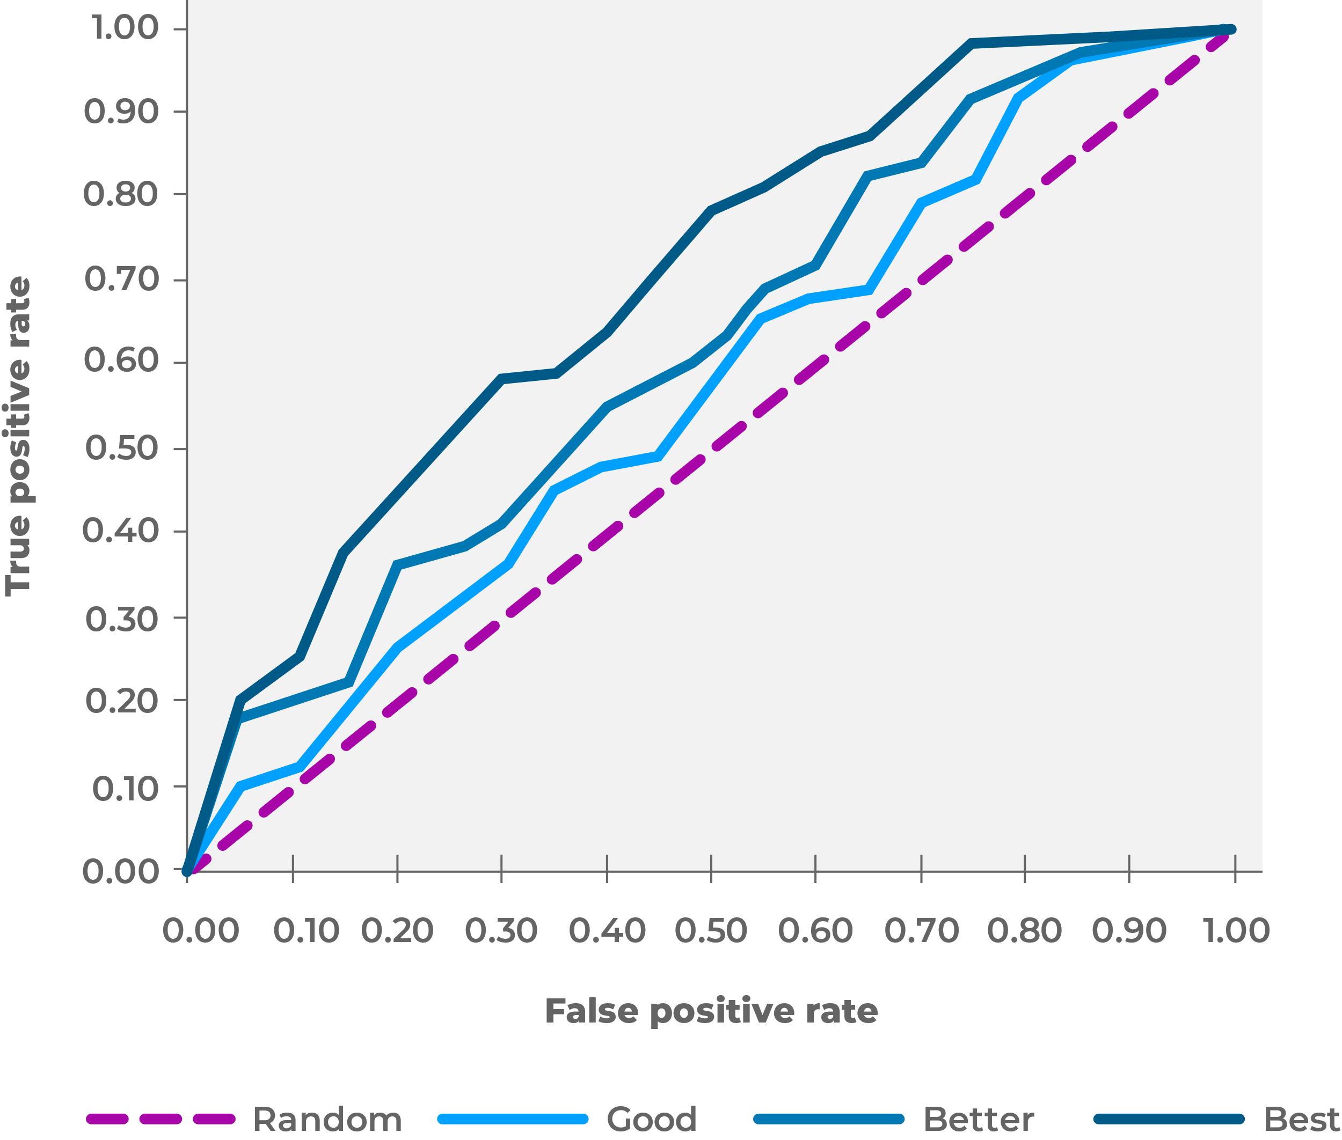
Area under Curve (AUC)
ROC (Receiver Operating Characteristics) curve
Area under ROC Curve is a performance metric for measuring the ability of a binary classifier to discriminate between positive and negative classes.
The ROC curve is created by plotting the true positive rate (TPR) against the false positive rate (FPR) at various threshold settings.
The true-positive rate is also known as sensitivity, recall or probability of detection in machine learning.
The false-positive rate is also known as probability of false alarm
Source adapted from: roc-theory-small.png

Slide 25
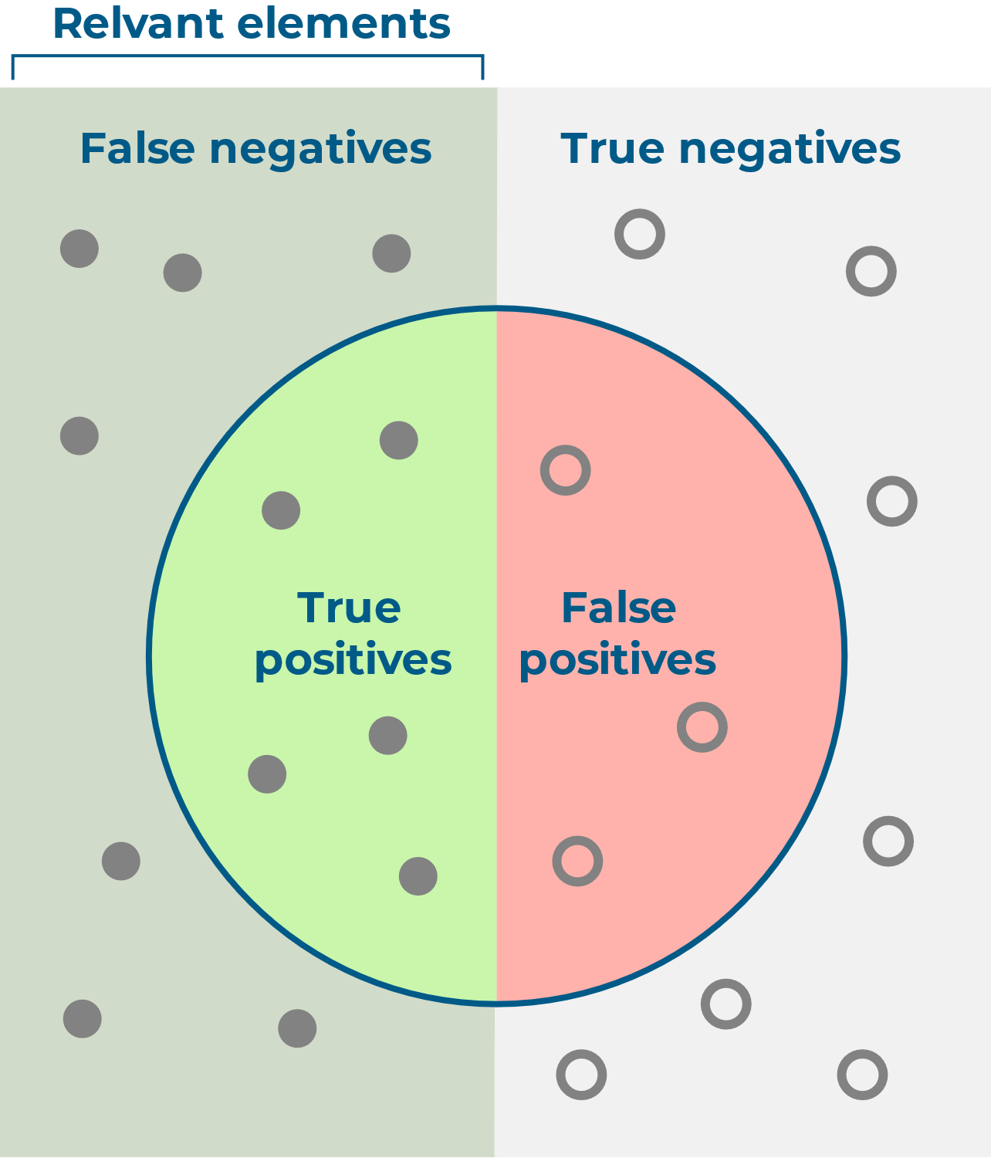
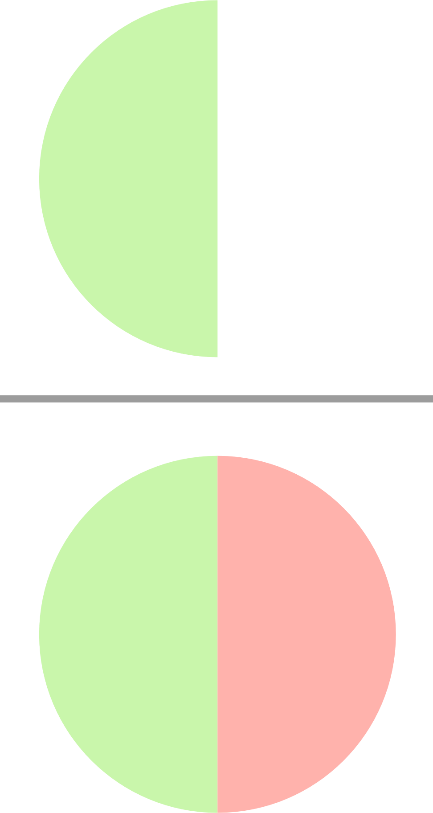

F-measure
F-measure (also F-score) is a measure of a test’s accuracy that considers both the precision and the recall of the test to compute the score.
How many selected items are relevant?
How many relevant items are selected?
Precision =
Recall =
Source:https://en.wikipedia.org/wiki/File:Precisionrecall.svg

Slide 26
F-measure
Precision: is the number of correct positive results divided by the total predicted positive observations.
Recall: is the number of correct positive results divided by the number of all relevant samples (total actual positives).
It tells you how precise your classifier is (how many instances it classifies correctly), as well as how robust it is (it does not miss a significant number of instances).
Further Reading: https://towardsdatascience.com/metrics-to-evaluate-your-machine-learning-algorithm-f10ba6e38234

Slide 27
Naïve Bayes (NB)

Slide 28


Naive Bayes Classifier
A simple technique.
Does not use rules, a decision tree or any other explicit representation of the classifier.
Assign class labels to problem instances, represented as vectors of feature values, where the class labels are drawn from some finite set.
Uses probability theory.
To find the most likely of the possible classifications
Assumes that the value of a particular feature is independent of other features.

Slide 29
Example: Naive Bayes Classification Task
Loan Classification/Prediction
A loan applicant is desirable or not depending on a person income, previous loan and transaction history, age, and location.
Even if these features are interdependent, these features are still considered independently.
This assumption simplifies computation, and that's why it is considered as naive.
This assumption is called Class Conditional Independence.

Slide 30
Types of Naive Bayes
Gaussian Naive Bayes Classifier
Multinomial Naive Bayes Classifier
Bernoulli Naive Bayes Classifier

Slide 31
Gaussian Naive Bayes classifier
Used when features are not discrete.
Used when the features have continuous values.
Assumed that all the features are following a gaussian distribution i.e, normal distribution.
Further Reading: https://scikit-learn.org/stable/modules/naive_bayes.html#

Slide 32
Multinomial Naive Bayes Classifier
Used when features follow a multinomial distribution.
Suitable for classification with discrete features (e.g., word counts for text classification).
Requires integer feature counts.
Further Reading: https://scikit-learn.org/stable/modules/naive_bayes.html#

Slide 33
Bernoulli Naive Bayes classifier
Used when features are of the boolean type.
There may be multiple features but each one is assumed to be a binary-valued (Bernoulli, boolean) variable.
This class requires samples to be represented as binary-valued feature vectors; if handed any other kind of data, a BernoulliNB instance may binarize its input (depending on the binarize parameter).
Further Reading: https://scikit-learn.org/stable/modules/naive_bayes.html#

Slide 34
Probability Theory
The probability of an event.
For Example:
The 6.30 p.m. train from London to your local station arrives on time, is a number from 0 to 1 inclusive, with 0 indicating ‘impossible’ and 1 indicating ‘certain’.
A fruit may be considered to be an apple if it is red, round, and about 10 cm in diameter.
A Naive Bayes classifier considers each of these features to contribute independently to the probability that this fruit is an apple, regardless of any possible correlations between the color, roundness, and diameter features.

Slide 35
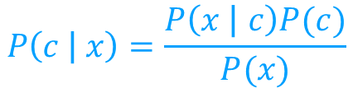
Probability Theory Algorithm
Bayes theorem provides a way of calculating the posterior probability, P(c|x), from P(c), P(x), and P(x|c).
Conditional independence.
P(c|x) is the posterior probability of class (target) given predictor (attribute).
P(c) is the prior probability of class.
P(x|c) is the likelihood which is the probability of predictor given class.
P(x) is the prior probability of predictor.
Class Prior Probability
Likelihood
Posterior Probability
Predictor Prior Probability

Slide 36
Example - Weather Dataset
Outlook | Temp | Humidity | Windy | Play Golf
Rainy | Hot | High | False | No
Rainy | Hot | High | True | No
Overcast | Hot | High | False | Yes
Sunny | Mild | High | False | Yes
Sunny | Cool | Normal | False | Yes
Sunny | Cool | Normal | True | No
Overcast | Cool | Normal | True | Yes
Rainy | Mild | High | False | No
Rainy | Cool | Normal | False | Yes
Sunny | Mild | Normal | False | Yes
Rainy | Mild | Normal | True | Yes
Overcast | Mild | High | True | Yes
Overcast | Hot | Normal | False | Yes
Sunny | Mild | High | True | No
Source: https://www.saedsayad.com/naive_bayesian.htm

Slide 37
Naive Bayes Algorithm
The posterior probability can be calculated by first, constructing a frequency table for each attribute against the target.
Then, transforming the frequency tables to likelihood tables
Use the Naive Bayesian equation to calculate the posterior probability for each class.
The class with the highest posterior probability is the outcome of prediction.

Slide 38







Posterior Probability:
Posterior Probability:
Frequency Table |  | Play Golf
 |  | Yes | No
Outlook | Sunny | 3 | 2
 | Overcast | 4 | 0
 | Rainy | 2 | 3
Frequency Table |  | Play Golf
 |  | Yes | No
Outlook | Sunny | 3 | 2
 | Overcast | 4 | 0
 | Rainy | 2 | 3
Likelihood Table |  | Play Golf
 |  | Yes | No
Outlook | Sunny | 3 | 2 | 5/14
 | Overcast | 4 | 0 | 4/14
 | Rainy | 2 | 3 | 5/14
 |  | 9/14 | 5/14
Likelihood Table |  | Play Golf
 |  | Yes | No
Outlook | Sunny | 3 | 2 | 5
 | Overcast | 4 | 0 | 4
 | Rainy | 2 | 3 | 5
 |  | 9/14 | 5/14
Source: https://www.saedsayad.com/naive_bayesian.htm

Slide 39
Frequency Table
Likelihood Table
 |  | Play Golf
 |  | Yes | No
Outlook | Sunny | 3 | 2
 | Overcast | 4 | 0
 | Rainy | 2 | 3
 |  | Play Golf
 |  | Yes | No
Outlook | Sunny | 3/9 | 2/5
 | Overcast | 4/9 | 0/5
 | Rainy | 2/9 | 3/5
 |  | Play Golf
 |  | Yes | No
Humidity | High | 3 | 4
 | Normal | 6 | 1
 |  | Play Golf
 |  | Yes | No
Humidity | High | 3/9 | 4/5
 | Normal | 6/9 | 1/5
The likelihood tables for all four predictors.
 |  | Play Golf
 |  | Yes | No
Temp. | Hot | 2 | 2
 | Mild | 4 | 2
 | Cool | 3 | 1
 |  | Play Golf
 |  | Yes | No
Temp. | Hot | 2/9 | 2/5
 | Mild | 4/9 | 2/5
 | Cool | 3/9 | 1/5
 |  | Play Golf
 |  | Yes | No
Windy | False | 6 | 2
 | True | 3 | 3
 |  | Play Golf
 |  | Yes | No
Windy | False | 6/9 | 2/5
 | True | 3/9 | 3/5
Source: https://www.saedsayad.com/naive_bayesian.htm

Slide 40


Final Result
In this example we have 4 inputs (predictors). The final posterior probabilities can be standardized between 0 and 1.
Outlook | Temp | Humidity | Windy | Play Golf
Rainy | Cool | High | True | ?

Slide 41
Naive Bayes - Advantages & Disadvantages
Advantages
Easy to implement
Good results obtained in most of the cases
Disadvantages
Assumption: class conditional independence, therefore loss of accuracy
Practically, dependencies exist among variables
E.g., hospitals: patients: Profile: age, family history, etc. Symptoms: fever, cough etc., Disease: lung cancer, diabetes, etc.
Dependencies among these cannot be modeled by Naïve Bayes Classifier

Slide 42
Useful Resources
https://towardsdatascience.com/naive-bayes-classifier-81d512f50a7c
https://machinelearningmastery.com/naive-bayes-for-machine-learning/
https://blog.floydhub.com/naive-bayes-for-machine-learning/
https://www.datacamp.com/community/tutorials/naive-bayes-scikit-learn

